Slide 1
Weather App
By Ian Chow
Course Title: CM1040 Web Development
Assessment: Mid Term Coursework 1

Slide 2
Agenda
01
04
Introduction
Topic 5 Overview
02
05
Topic 3 Overview
Experiment 2 Setup and Findings
03
06
Connecting the Dots
Experiment 1 Setup and Findings

Slide 3
Introduction
What the project is about
Which two topics I chose and why

Slide 4
Exploring Responsive Layouts & Dynamic Data in Web Development
In this presentation, I explore two key topics from this course:
Topic 3: Layout for Different Devices
Topic 5: Working with Data Sources and Data Security
I chose these 2 topics as they are an accurate representation of web development in the real world, which needs to:
Display content cleanly across different devices
Fetch and handle live data securely
To bring these ideas to life, I will create a mini weather app as my experiment which would:
Adapt its layout across screen sizes (Topic 3)
Fetch live weather data from a REST API using JavaScript (Topic 5)
This project also draws on my experience with lab worksheets, course materials, and additional reading to deepen my technical understanding.

Slide 5
Topic 3 Overview
Responsive Layout for Different Devices

Slide 6
Building Layouts That Adapt to Any Screen
What is Responsive CSS?
CSS that adapts layout and styles based on device characteristics like screen width using media queries
Users access websites from desktops, tablets and phones. A responsive layout ensures consistent usability and aesthetics across different devices
Media Queries (example)
@media only screen and (min-width: 768px){
.container {
background-color: blue;
}
}
Mobile-First Design
Start with layout for small screens (1 column), then enhance for larger ones (e.g., 2 or 3 columns)
.container {
display: grid;
grid-template-columns: 1fr;
}
@media (min-width: 768px){
.container {
grid-template-columns: 1fr 1fr 1fr;
}
}
Browser Tools: Use Chrome DevTools Responsive Design Mode to preview layouts on different device sizes.

Slide 7
Experiment 1 Setup and Findings
Using raw CSS and Bootstrap’s Grid System and comparing the two

Slide 8
Example HTML
body {
font-family: Arial, sans-serif;
margin: 0;
padding: 1rem;
background: #f4f4f4;
}
h2 {
text-align: center;
}
.container {
display: grid;
grid-template-columns: 1fr;
gap: 1rem;
margin: 0 auto;
max-width: 1200px;
}
.box {
background-color: #007bff;
color: white;
padding: 2rem;
text-align: center;
border-radius: 10px;
font-size: 1.2rem;
}
/* Tablet: 2 columns */
@media (min-width: 600px) {
.container {
grid-template-columns: repeat(2, 1fr);
}
}
/* Desktop: 3 columns */
@media (min-width: 992px) {
.container {
grid-template-columns: repeat(3, 1fr);
}
}
<body>
<h2>Responsive Grid Demo</h2>
<div class="container">
<div class="box">1</div>
<div class="box">2</div>
<div class="box">3</div>
<div class="box">4</div>
<div class="box">5</div>
<div class="box">6</div>
</div>
</body>

Slide 9
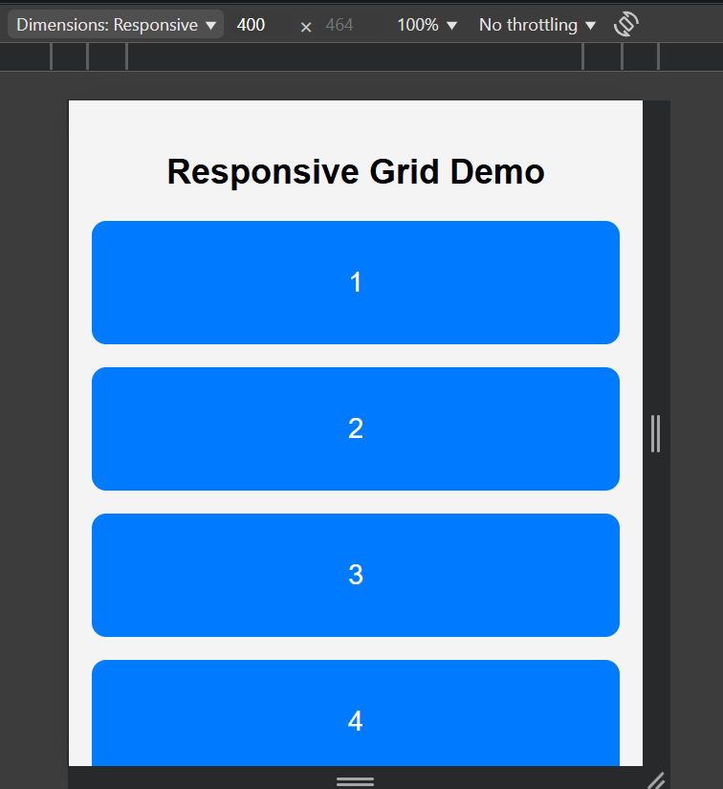
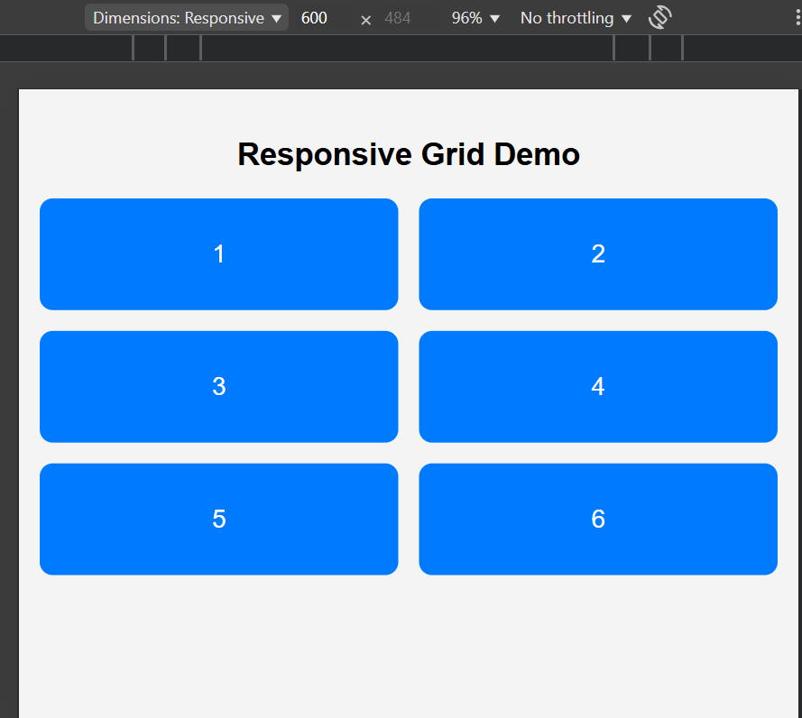
Comparison of different layouts
Phone Layout: Width < 600px
Tablet Layout: Width >= 600px

Slide 10
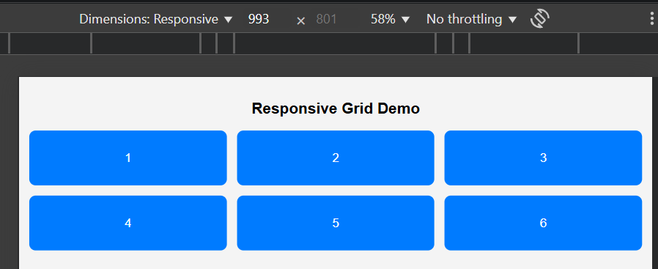
Comparison of different layouts
Desktop Layout: Width >= 992px

Slide 11
Raw CSS Grid vs CSS Frameworks – Which Handles Responsiveness Better?
I compared 2 layout approaches to explore responsive design
Raw CSS Grid + Media Queries
Bootstrap 5 Grid System (CSS Framework)
Raw CSS Grid (example)
Manual control over breakpoints using @media queries
Custom grid-template-columns and layout logic
Mobile-first: Start with 1 column, add more at wider widths
@media (min-width: 600px){
.container { grid-template-columns: 1fr 1fr; }
}
@media (min-width: 992px){
.container { grid-template-columns: 1fr 1fr 1fr; }
}
Bootstrap 5 Grid System
Uses predefined breakpoints (.col-sm-*, .col-md-*, .col-lg-*)
Built-in mobile-first design with flexbox layout
Faster to implement, but less control over adjustments of styles
<div class="row">
<div class="col-12 col-md-6 col-lg-4">Column</div>
...
</div>

Slide 12
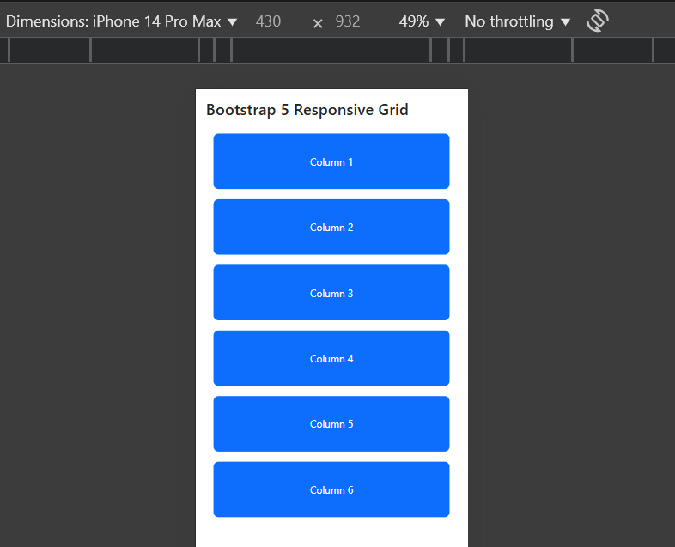
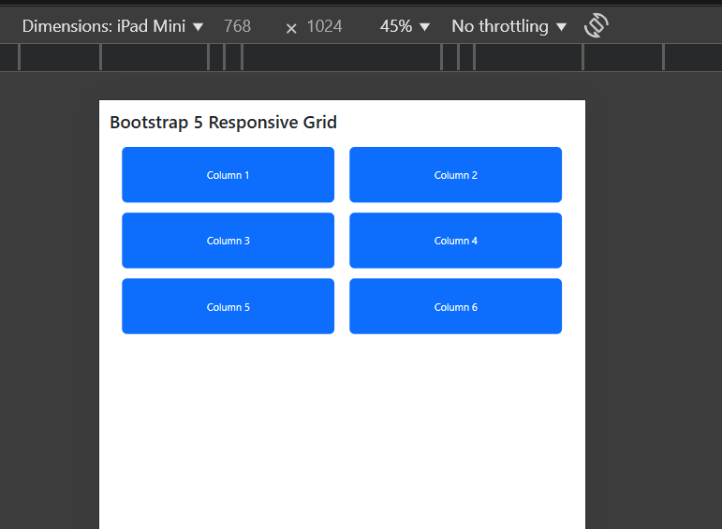
Comparison of different layouts in Bootstrap
Phone Layout: Width < 600px
Tablet Layout: Width >= 600px

Slide 13
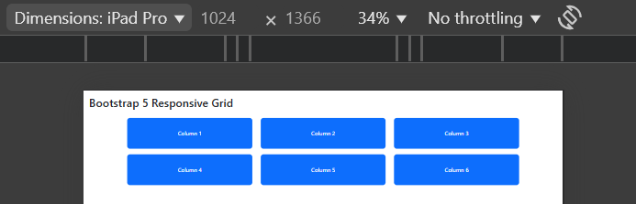
Comparison of different layouts in Bootstrap
Desktop Layout: Width >= 992px

Slide 14
How do Raw CSS and Bootstrap Compare for Responsive Layouts?
Test Conditions Recap:
Layouts viewed on 3 screen sizes:
Mobile (< 600px)
Table (600px – 991px)
Desktop (> 991px)
Conclusion:
Raw CSS offers precision and flexibility, but it is more time-consuming to set up
Bootstrap is ideal for faster, mobile-first design.
Feature | Raw CSS Grid + Media Queries | Bootstrap 5 Grid System
Control | Fine-tuned with full flexibility | Preset breakpoints and classes
Setup Speed | Slower, manual styling | Faster, quick layout setup
Code Complexity | More verbose and customized | More concise and less code
Responsiveness Quality | Good when configured well with classes and ids in HTML | Good with built in logic within HTML

Slide 15
Topic 5 Overview
JSON & Local Data with JavaScript

Slide 16
Understanding JSON and Accessing Local Data
What is JSON?
JavaScript Object Notation
Human-readable data format used for data exchange
Supports strings, numbers, arrays, and nested objects
{
"student": "Ian",
"course": "CM1040",
"modules": ["HTML", "CSS", "JavaScript"],
"Year": 1
}
Why use JSON over other data structures like XML?
Easier than XML for structuring data
Lightweight, fast to parse in JavaScript
Used for configuration files, datasets and mock APIs
Loading Local JSON Data with JavaScript
fetch('./data.json')
.then(response => response.json())
.then(data => {
console.log(data.student); // Output: Ian
}).catch(err => console.log(err)).finally(()=> console.log("Done"))

Slide 17
Retrieving Live Data from the Web with REST APIs
What is a REST API?
API: Application Programming Interface
REST: Uses HTTP methods (GET, POST) to interact with resources
Responds with data, usually in JSON format
Why use APIs in Web Development?
Access real-time information from external sources (e.g., weather, news)
Lightweight, fast to parse in JavaScript
Used for configuration files, datasets and mock APIs
Example: Fetching Weather from API
fetch('https://api.example.com/weather')
.then(res => res.json())
.then(data => {
document.getElementById('temp').textContent = data.temperature + "°C";
});
Security Tip:
Use HTTPS, handle errors (.catch()), and validate user input to protect data integrity.

Slide 18
Experiment 2 Setup and Findings
Creating a weather app that utilizes both API calls and Bootstrap for its layout

Slide 19
Dynamic Weather App: Real-Time Data & Responsive Design
Objective:
Create a weather app that:
Accepts user input (city name)
Retrieves live weather forecasts using OpenWeatherMap’s REST API
Displays results in a responsive table layout
Demonstrates use of JSON, JavaScript (React + Axios), and Bootstrap
Tools & Tech Used:
React.js
OpenWeatherMap API (geolocation + 5-day forecast endpoints)
Axios (for HTTP requests)
Bootstrap 5 (responsive table + layout)
Data Fetching Flow (handleSubmit2)
1. Use city name to get geo coordinates via:
axios
.get(
`https://api.openweathermap.org/geo/1.0/direct?q=${this.state.cityInput}&limit=1&appid=db2b631c79deae1500162a294faec7dc`
)
.then((response) => response.data[0])
2. Use lat/lon to fetch forecast data:
.then((cityGeoData) =>
axios.get(
`https://api.openweathermap.org/data/2.5/forecast?lat=${cityGeoData.lat}&lon=${cityGeoData.lon}&appid=db2b631c79deae1500162a294faec7dc&units=metric`
)
)
3. Parse and display using .map() to render forecast rows

Slide 20
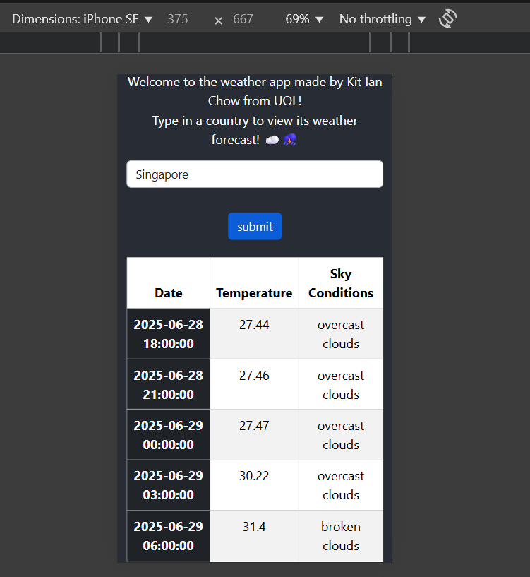
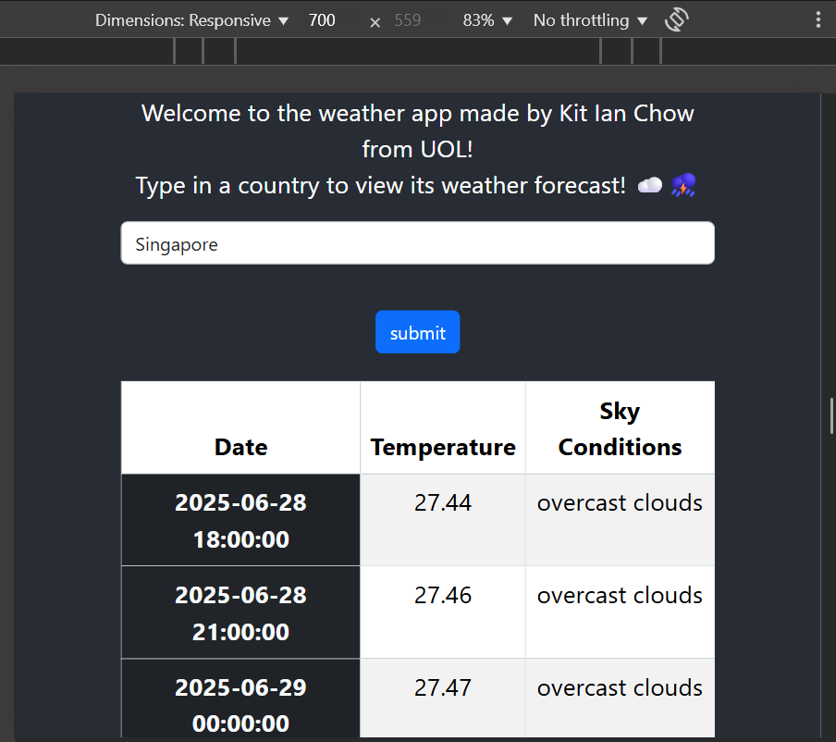
Comparison of different layouts
Phone Layout: Width < 600px
On mobile, column width is col-12 and the form and content is the full width (with some padding)
Tablet Layout: Width >= 600px
On tablet, column width is col-md-8 and the form and content is 66% of the width and centered

Slide 21
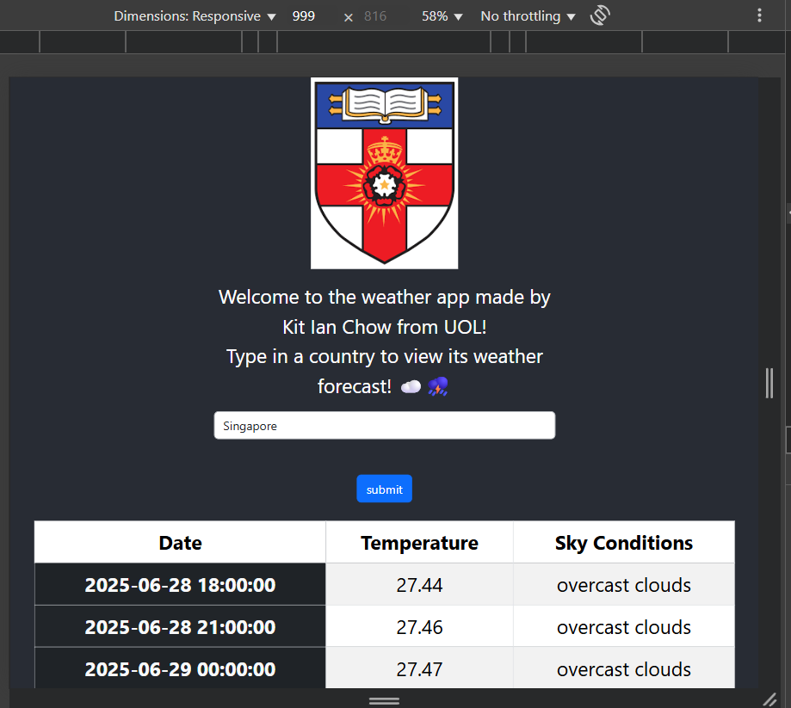
Comparison of different layouts
Desktop Layout: Width >= 992px
On desktop, column width is col-lg-6 and the form and content is 50% of the width and centered.

Slide 22
What I Learned from Building the Weather App
Key Discoveries
1. JSON is flexible & easy to parse
JSON structure makes it straightforward to extract weather details such as temperature, sky conditions and date.
2. REST APIs deliver real-time data
OpenWeatherMap’s REST API let me pull dynamic data using just country input
3. Axios simplifies asynchronous requests
Compared to fetch(), Axios gave cleaner .then() chaining and better error handling with .catch()
Responsiveness Insights:
1. Bootstrap grid enables mobile first design
I used col-12 col-md-8 col-lg-6 to ensure layout adapts across screen sizes
2. Clean separation of logic and layout
Logic was placed in handler functions such as handleSubmit for fetching the weather data while layout utilized Bootstrap’s resuable classes
Conclusion
This experiment showed how responsive layouts and live data integration work hand-in-hand to create a modern dynamic web experience.

Slide 23
Connecting the Dots
Creating a weather app that utilizes both API calls and Bootstrap for its layout

Slide 24
Bringing It All Together
Connecting the Two Topics
1. Topic 3 (Responsive Layouts) taught me how to design user-friendly interfaces across devices using:
CSS Grid & Media Queries (raw CSS)
Boostrap’s mobile-first grid system
2. Topic 5 (Data & Security) strengthened my understanding of:
JSON formatting and structure
Fetching and rendering live data using REST APIs and JavaScript (React + Axios)
Key Takeaways
I realized how frontend design and backend data integration must work together to build effective apps and how to manage API requests, error handing and conditional rendering in React.
Bootstrap helped me quickly prototype a layout and using axios allowed me to fetch and handle JSON data from the weather API.
Final Reflection
This weather app project gave me hands-on experience in building a real world application and I could create an app that is responsive in design and data-driven.

Slide 25
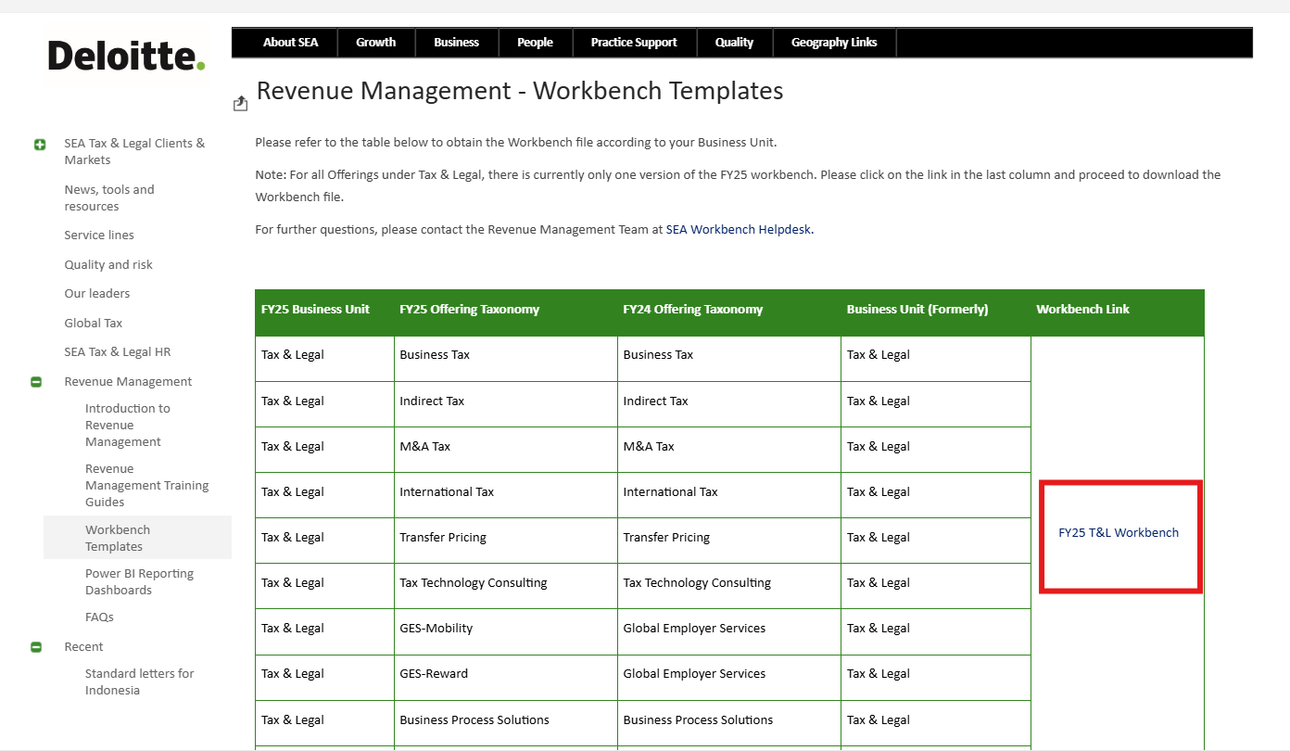
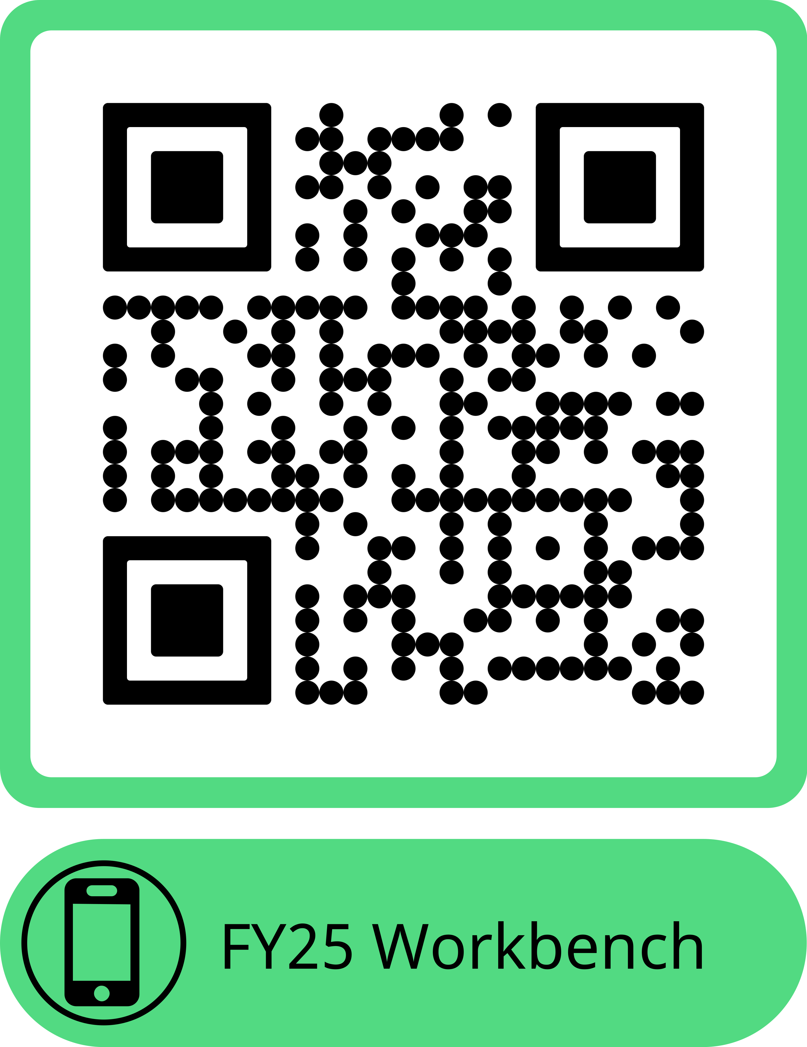
Location of Workbench templates

